Slide 1
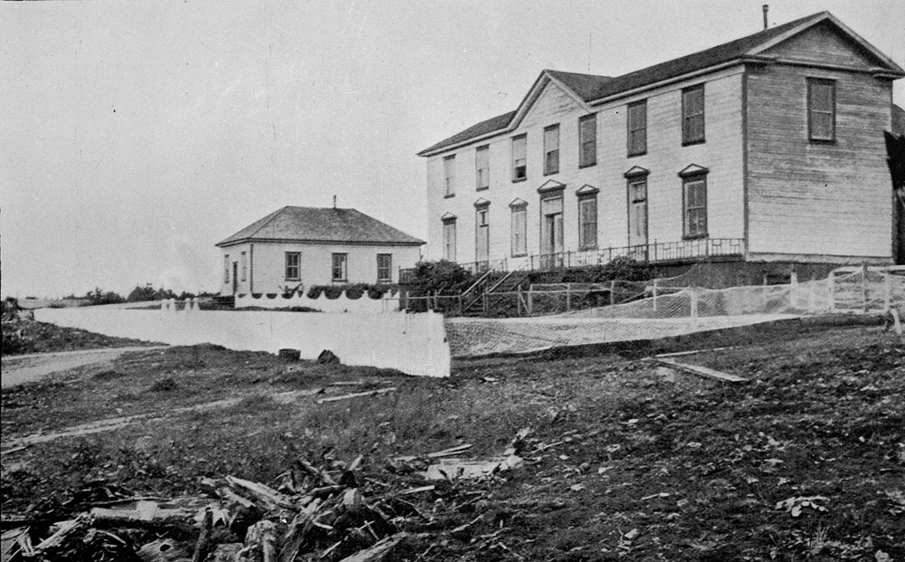
Residential schooling for indigenous children: the harmful practices of residential school and THEIR IMPACT ON THE INDIGENOUS POPULATION
Jessica Slade
Metlakatla Indian Residential School at close quarters (boys), pupils away for most part on summer holidays, British Columbia, ca. 1900-1902 (http://collectionscanada.gc.ca/pam_archives/index.php?fuseaction=genitem.displayEcopies&lang=eng&rec_nbr=3532487&title=Metlakatla+Indian+Residential+School+at+close+quarters+%28boys%29%2C+pupils+away+for+most+part+on+summer+holidays%2C+British+Columbia%2C+ca.+1900-1902++&ecopy=c056781-v8)

Slide 2
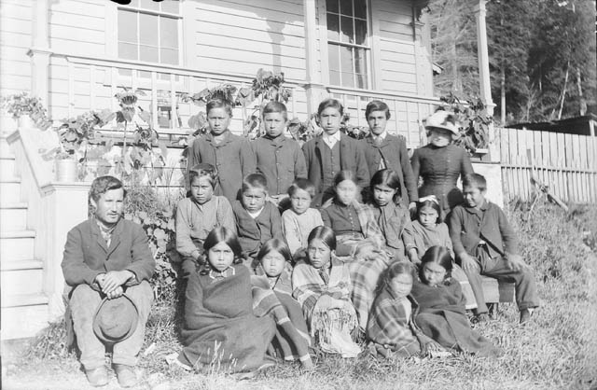
Why?
Offers the opportunity to study something different
Availability of sources
To increase acknowledgement of the treatment of Indigenous peoples within residential schools
Importance of understanding how your school experience can shape the person you become in the future
Group of students at Alert Bay Mission School, British Columbia, 1885 (http://collectionscanada.gc.ca/pam_archives/index.php?fuseaction=genitem.displayEcopies&lang=eng&rec_nbr=3194035&title=Group+of+students+at+Alert+Bay+Mission+School%2C+British+Columbia%2C+1885++&ecopy=a037934)

Slide 3
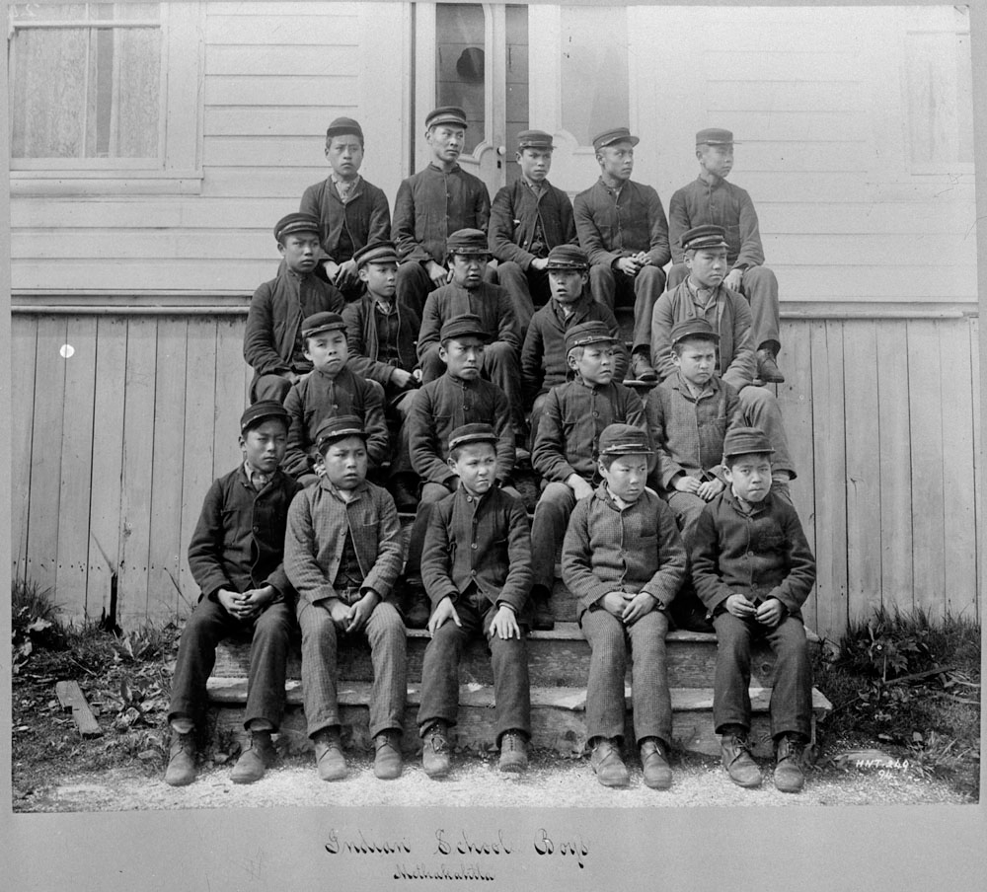
Background
Residential schools operated between 1870 and 1990, the last being closed in 1996
Indian act of 1876 – required the government to provide Indigenous youth with an education and to integrate them into Canadian society.
Operated by Churches/Religious Institutions
General experience was overwhelmingly negative
Attempt to assimilate the children into mainstream society
Brought up for Inferiority
Failed to provide adequate education, which only began to change in the 1950’s.
Students attending the Metlakatla Indian Residential School, British Columbia, date unknown (http://collectionscanada.gc.ca/pam_archives/index.php?fuseaction=genitem.displayEcopies&lang=eng&rec_nbr=3194929&title=Students+attending+the+Metlakatla+Indian+Residential+School%2C+British+Columbia%2C+date+unknown++&ecopy=c015037-v8)

Slide 4
Did Residential schools change over time?
By 1951, the half day work school system was abandoned
Amendments to the Indian Act
Indigenous children were allowed to live with their parents wherever possible
More qualified teachers were hired
1969 DIA took schools over from the churches, ending church involvement
Phasing out of segregation and incorporation of Indigenous children into public schools
Didn’t prevent abuse in schools
Still had unqualified/poorly qualified teachers

Slide 5
Main Ideas
Residential School Practices | Impacts of Residential schooling
Forced assimilation | Alcohol and drug abuse
Removal of Indigenous culture | Suicide
Physical, mental and sexual abuse | Suffered Racism in mainstream society
Underfunding | Chronic Depression
Lack of Care | Dysfunctional families and relationships
Punishment | Low self-esteem and confidence

Slide 6
Bibliography
Barman, Jean. Schooled for Inequality: The education of British Columbia Aboriginal children. Schooling in Transition. Readings in Canadian history of education. University of Toronto Press. Toronto Buffalo London. 2012.
Barnes, Rosemary, and Nina Josefowitz. “Indian Residential Schools in Canada: Persistent Impacts on Aboriginal Students’ Psychological Development and Functioning.” Canadian Psychology/Psychologie Canadienne, July 5, 2018.
Battiste, Marie. Enabling the Autumn seed: Toward a decolonised approach to Aboriginal Knowledge, Language and Education. Schooling in Transition. Readings in Canadian history of education. University of Toronto Press. Toronto Buffalo London. 2012.
Canada’s Residential Schools: The Final Report of the Truth and Reconciliation Commission of Canada. McGill-Queen’s Native and Northern Series: 80-86. Montreal; Kingston; London ; Chicago : Published for The Truth and Reconciliation Commission of Canada by McGill-Queen’s University Press, 2016-, 2016.
Daniella Zalcman. “‘Kill the Indian, Save the Man’: On the Painful Legacy of Canada’s Residential Schools,” no. 3 (2016): 72-85 Duke University Press, 2016
David B. MacDonald, and Graham Hudson. “The Genocide Question and Indian Residential Schools in Canada.” Canadian Journal of Political Science / Revue Canadienne de Science Politique 45, no. 2 (2012)
Feir, Donna L. “The Long-Term Effects of Forcible Assimilation Policy: The Case of Indian Boarding Schools.” Canadian Journal of Economics 49, no. 2 (May 2016): 433–80.
http://data2.archives.ca/e/e444/e011080292-v8.jpg (primary source picture)
Intergenerational Impacts of Residential Schools (http://www.rcmp-grc.gc.ca/aboriginal-autochtone/lp-pl/doc/2res-school-9-12-pen-indiens-9-12-oh3-eng.pdf)
Library and Archives Canada, “NORTH BLACKFOOT AGENCY - GENERAL CORRESPONDENCE RELATING TO THE OLD SUN'S DAY SCHOOL AND IT'S CLOSING.”, Accessed 11th February 2019, http://www.collectionscanada.gc.ca/lac-bac/results/arch?form=arch_simple&lang=eng&FormName=MIKAN+Simple+Search&PageNum=1&SortSpec=score+desc&HighLightFields=title%2Cname&Language=eng&QueryParser=lac_mikan&Sources=mikan&Archives=&SearchIn_1=&SearchInText_1=residential+school+records&Operator_1=AND&SearchIn_2=&SearchInText_2=&Operator_2=AND&SearchIn_3=&SearchInText_3=&Media%5B%5D=800&Level=&MaterialDateOperator=after&MaterialDate=&DigitalImages=1&Source=&cainInd=&ResultCount=10
Loyie, Larry, Wayne K. Spear, and Constance Brissenden. Residential Schools: With the Words and Images of Survivors. Brantford, Ontario: Indigenous Education Press, 2014.,
Milloy, John Sheridan, and Mary Jane McCallum. 2017. A National Crime: The Canadian government and the residential school system. Vol. Anniversary Edition. Critical studies in Native History. Winnipeg, Manitoba: University of Manitoba press.
Report on Native Education (1847) (http://projectofheart.ca/historical-documents/)
School Files Series - 1879-1953 (RG10) (http://www.collectionscanada.gc.ca/numerisation-microforme/006003-119.01 e.php?q2=2&q3=109&sqn=53&tt=2171&PHPSESSID=vuurgnbn4tsa636na4ig4lfg81)

Slide 7
Additional Readings
Library and Archives Canada, “NORTH BLACKFOOT AGENCY - GENERAL CORRESPONDENCE RELATING TO THE OLD SUN'S DAY SCHOOL AND IT'S CLOSING.”, Accessed 11th February 2019, http://www.collectionscanada.gc.ca/lac-bac/results/arch?form=arch_simple&lang=eng&FormName=MIKAN+Simple+Search&PageNum=1&SortSpec=score+desc&HighLightFields=title%2Cname&Language=eng&QueryParser=lac_mikan&Sources=mikan&Archives=&SearchIn_1=&SearchInText_1=residential+school+records&Operator_1=AND&SearchIn_2=&SearchInText_2=&Operator_2=AND&SearchIn_3=&SearchInText_3=&Media%5B%5D=800&Level=&MaterialDateOperator=after&MaterialDate=&DigitalImages=1&Source=&cainInd=&ResultCount=10
Wagamese, Richard. Indian Horse : A Novel. Vancouver : Douglas & McIntyre, 2012., 2012.
CBC, “In their own words” Accessed 16th March 2019, https://newsinteractives.cbc.ca/longform/residential-school-survivors
Daniella Zalcman. “‘Kill the Indian, Save the Man’: On the Painful Legacy of Canada’s Residential Schools,” no. 3 (2016): 72-85 Duke University Press, 2016

Slide 8
Conclusion
Intergenerational consequences
Severe damage on the indigenous peoples from the practices
Forced to believe they were an inferior class
Did nothing to improve their social standing
Reviews of the institutions are negative

